Slide 1
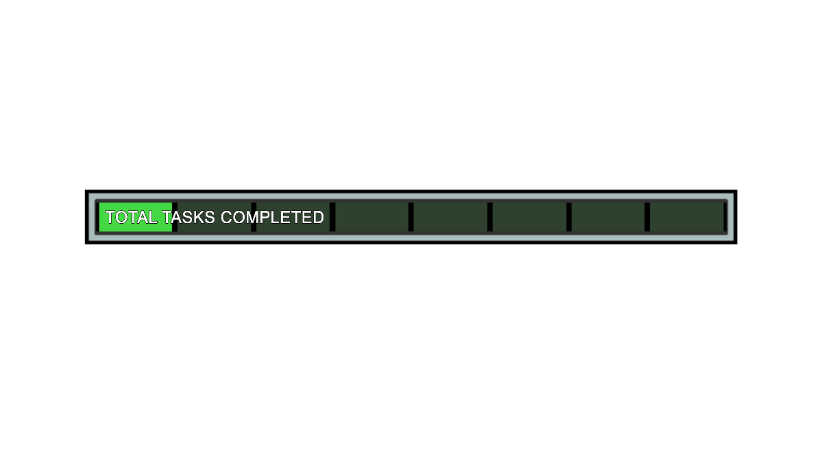







E-Sports among us
DATA
Objectives
To conduct analysis on E-Sports:
Population | Frequency
None of the above | 39
Play | 61
Watch | 26
Grand Total | 126
1. To check male and female involvement.
2. Preferred streaming website by Viewers.
3. Preferred Gaming by Players.
4. Age and E-Sports involvement.
5. Future for E-Sports.
Amaan entered the server.
Dhriti entered the server.
Sharwari entered the server.
Adith entered the server.
Insha entered the server.
6. Lockdown’s influence towards E-Sports.
Adith
Amaan
Dhriti
Sharwari
Insha

Slide 2
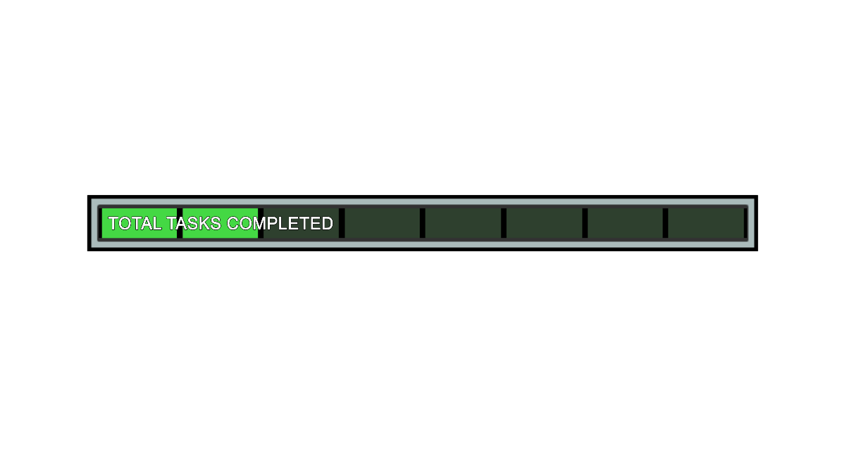
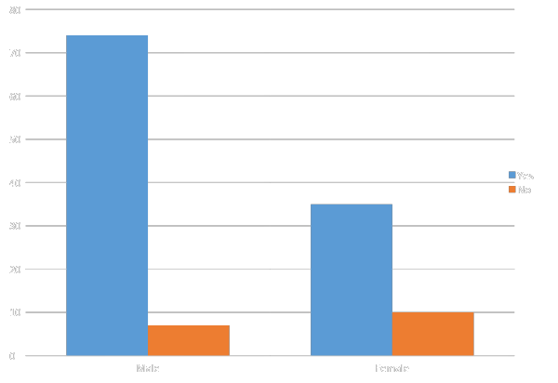
Awareness amongst people
N=126
Awareness
Gender | Yes | No | Total
Male | 74 | 7 | 81
Female | 35 | 10 | 45
Total | 109 | 17 | 126
Yule’s Coefficient of Association
Q=0.5025
Attributes:
A: Male
B: Yes
Adith

Slide 3
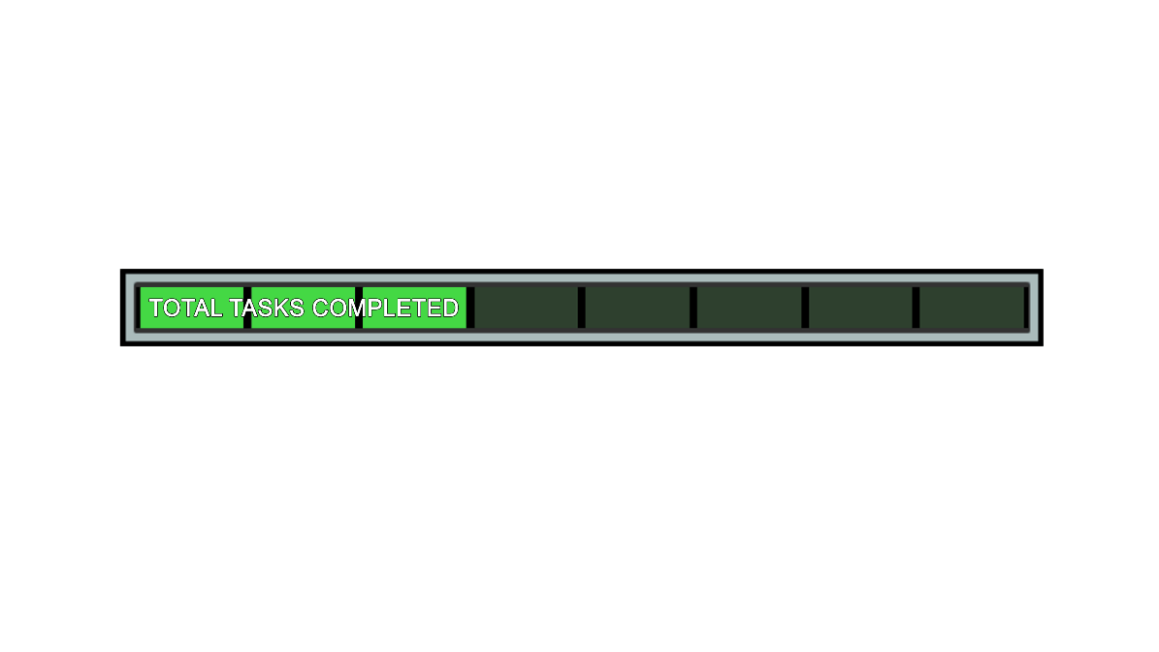
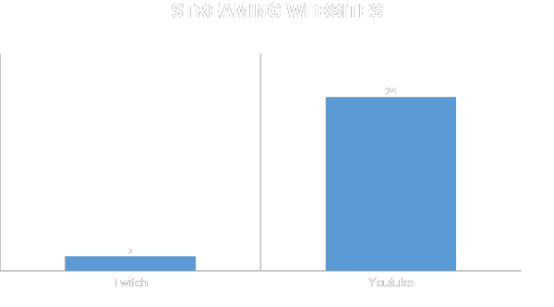
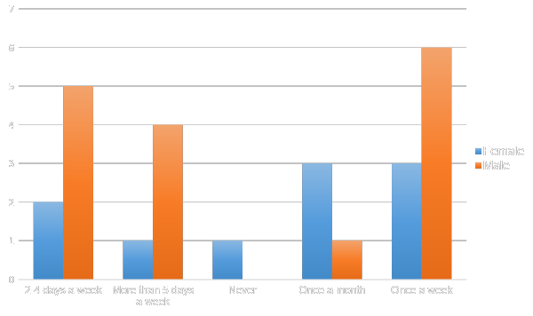

VIEWERS
N=26
Amaan

Slide 4
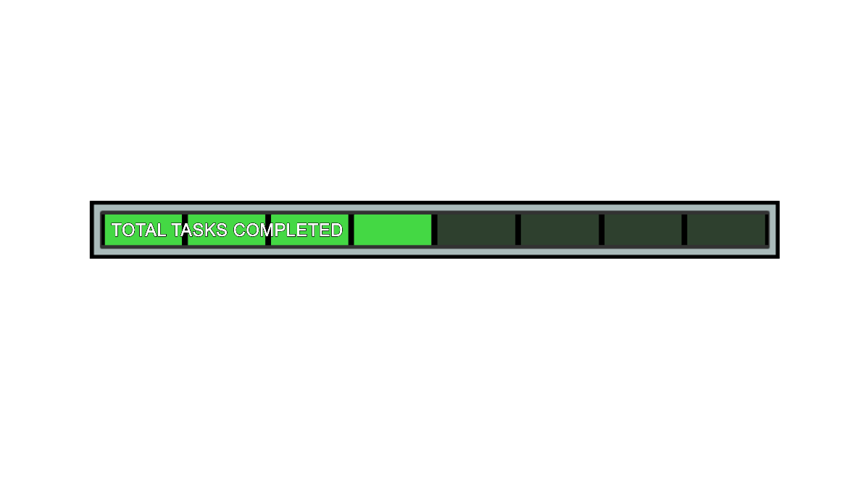
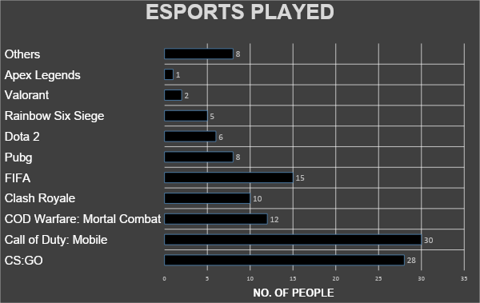
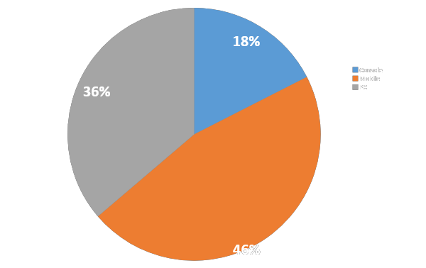
Players
N=61
Dhriti

Slide 5
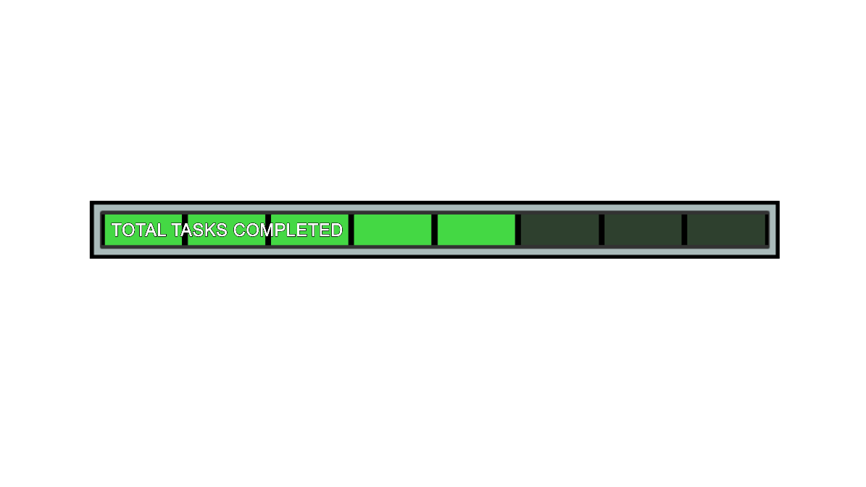
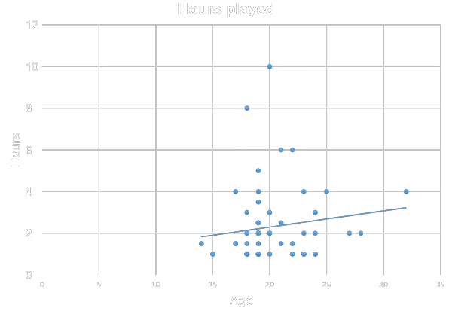
Players
Regression Statistics (Age v/s Hours spent by players)
R square | 0.019131
Standard Error | 3.088948
Observations | 61
N=61
Y: Hours Played
X: Age
Sharwari

Slide 6
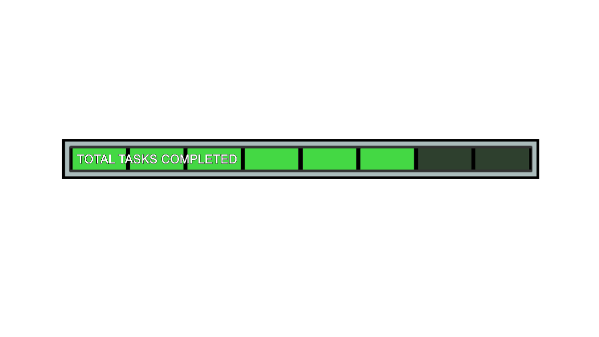
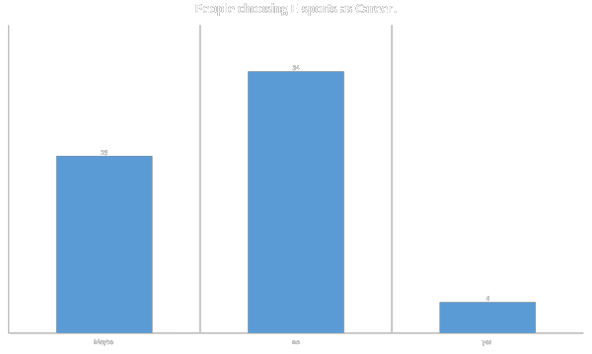
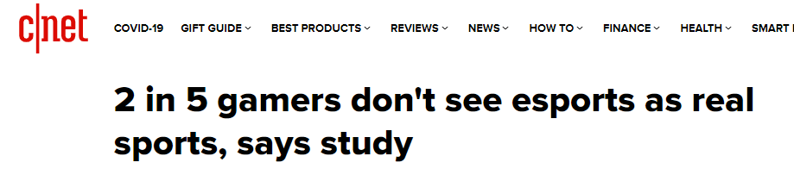

Career
N=87
N=61
Do you consider E-sports as a real sport? | No. of population (Players+Viewers)
Yes | 70
No | 17
Grand Total | 87
p:Proportion of people who consider E-Sport as a real sport.
Test for single proportion:
H₀: p=0.60
H₁: p>0.60
Decision Criterion:
If Z_{cal}>Z_{α}, Reject H₀ at 5% l.o.s.
Test Statistic:
Z_{cal}= 3.895
Z_{α} = 1.64
Thus, Z_{cal}>Z_{α}
Decision:
Reject H₀ at 5% l.o.s.
Claim:
Adith

Slide 7
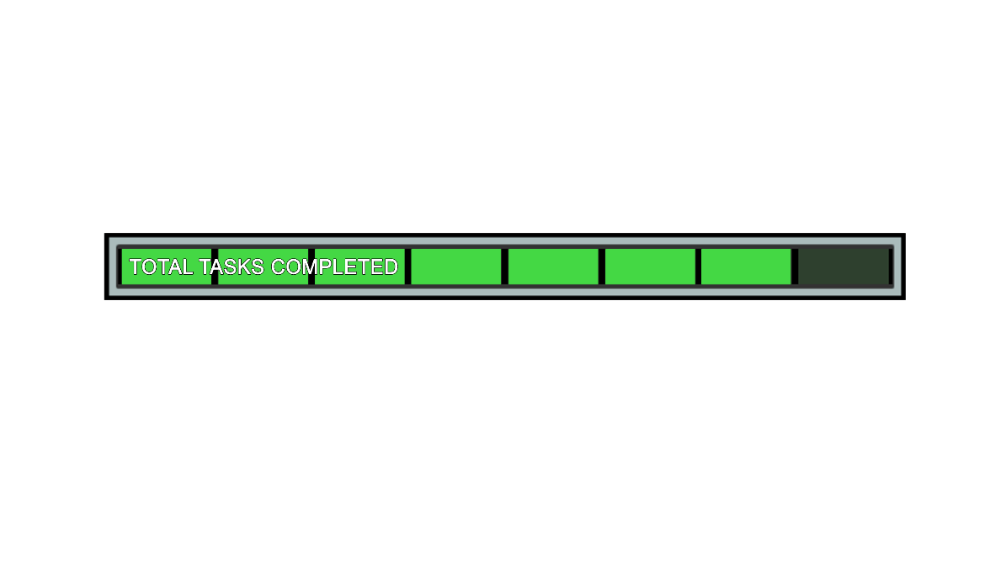

GENDERWISE INFLUENCE OF LOCKDOWN ON E-SPORTS
iGENDERWISE INFLUENCE OF LOCKDOWN ON E-SPORTS
VIEWERS | INFLUENCE OF LOCKDOWN |  | GRAND TOTAL
GENDER | YES | NO
MALE | 7 | 9 | 16
FEMALE | 8 | 2 | 10
TOTAL | 15 | 11 | 26
PLAYERS | INFLUENCE OF LOCKDOWN |  | GRAND TOTAL
GENDER | YES | NO
MALE | 10 | 37 | 47
FEMALE | 9 | 5 | 14
TOTAL | 19 | 42 | 61
VIEWERS
PLAYERS
H₀: P₁=P₂
H₁: P₁>P₂
Decision Criterion:
If Z_{cal}>Z_{α}, Reject H₀ at 5% l.o.s.
Test Statistic:
Z_{cal}= 1.82
Z_{α} = 1.64
Thus, Z_{cal}>Z_{α}
Decision:
Reject H₀ at 5% l.o.s.
P_{1:} Females.
P_{2:} Males.
H₀: P₁=P₂
H₁: P₁>P₂
Decision Criterion:
If Z_{cal}>Z_{α}, Reject H₀ at 5% l.o.s.
Test Statistic:
Z_{cal}= 3.05
Z_{α} = 1.64
Thus, Z_{cal}>Z_{α}
Decision:
Reject H₀ at 5% l.o.s.
Insha

Slide 8
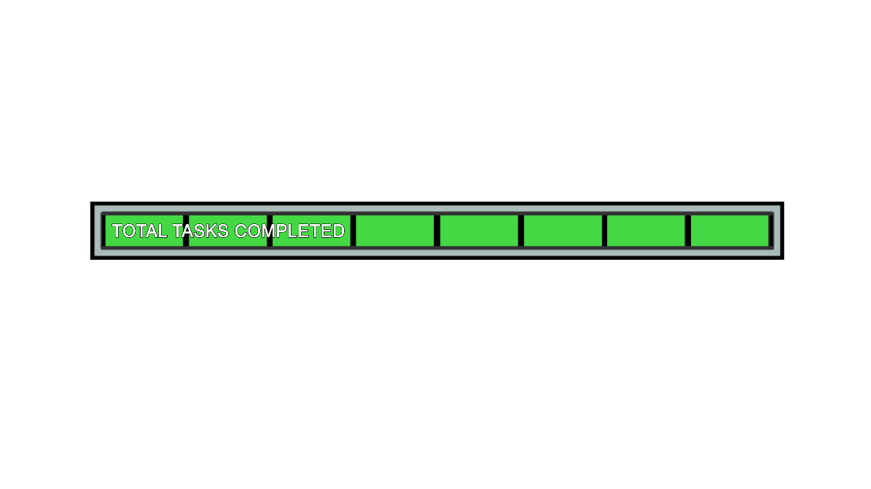

Conclusion
1. Males are more inclined towards E-sports but more and more females are joining the
E-Sports platform day by day.
2. People stream E-Sports gaming on YOUTUBE more in comparison to TWITCH.
3. People prefer Mobile Gaming more than PC gaming, while Console gaming is less preferred.
Amaan
4. 6% of the Player’s population would choose E-sports as their career.
5. 80% of the people believe E-sport to be a Real Sport.
6. Females have been more influenced by E-sports due to Lockdown.

Slide 9
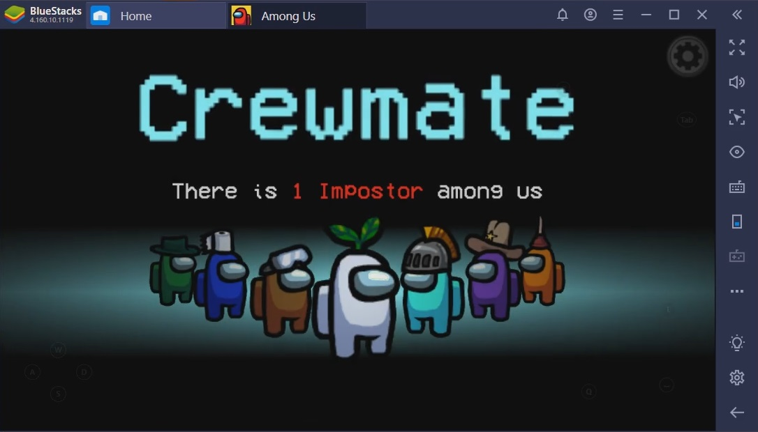
s
Thank you for hearing us patiently.
Have a nice day.
Adith
Sharwari
Amaan
Insha
Dhriti

